Slide 1
UI Design & Evaluation
CO2104
Changing Font Size Using Buttons

Slide 2
Changing Font Size Using Buttons
When you create a website you (as the designer) normally decide on the size of the text.
This is normally decided based on how much text you have within each section of the page.
Or on how good it looks.
But sometimes this could be too small for the end-user.
Especially if they are partially sighted or struggle with dyslexia.
What would be useful is if there is an option within the site that allows the user to alter the size of the text to match their needs.

Slide 3
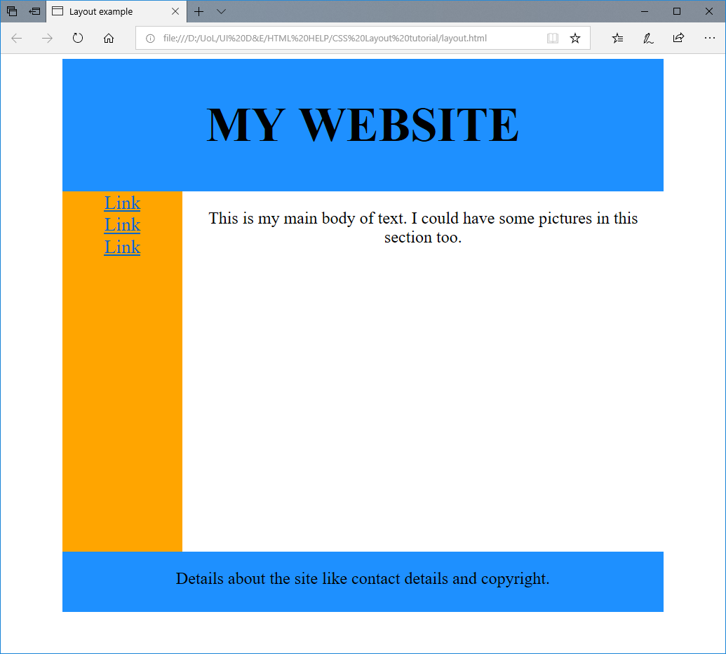
A starting point.
For this example I will be using the template page I made in the first handout in week 7 (CSS Layout tutorial).
This already has a CSS setup (which does not need to be altered).
But I will be adding eventually 3 buttons to the link bar that will allow me to…
Shrink the text.
Reset the text size.
Enlarge the text.
This will only change the size of the text found within the main body of the site.
This code will all be done in the HTML file

Slide 4
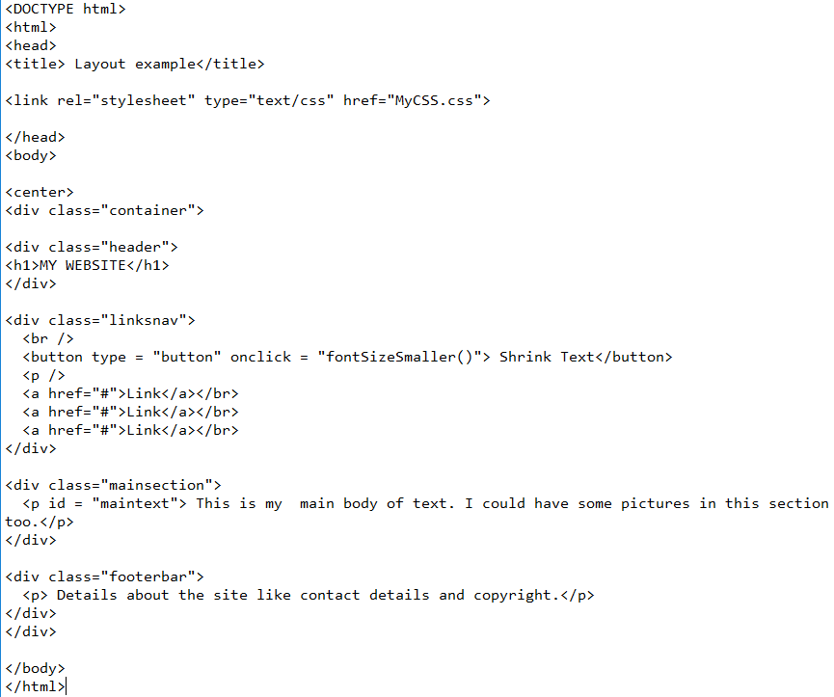
Changes to the HTML File – adding the first button
I then need to add a button to my HTML code.
I have placed this button within the linksnav DIV class, so they appear at the top of the link menu.
You this is linked to something called “fontSizeSmaller”, which is the name of the function I will be using in the JavaScript to change the size of the text.
The <br /> is a single line break. This helps me put each button (eventually) on a separate line.
The < p /> gives me a paragraph space.

Slide 5
Changes to the HTML File – adding an ID to the Paragraph tag in “mainsection”
You should also notice within the div class “mainsection” I have changed the <p> tag to include an ID.
I have changed…
<p>
…to be…
<p id = “maintext”>
This ID means I can reference this in my JavaScript.

Slide 6
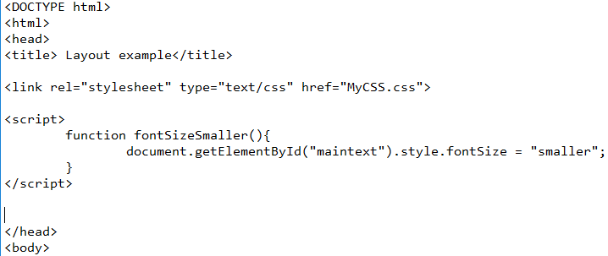
Now for the JavaScript
As this is going to be only 2 lines of code I have decided to add this to the top of my HTML.
But if you have a number of functions for a single page (like code for your menus) this would be better running from its own JavaScript file.
This is what my code looks like.
This will be explained on the next slide.

Slide 7
Now for the JavaScript
The function is called fontSizeSmaller, which we reference to in our button code in the HTML
This is saying we are changing the fontSize so that it equals “smaller”. This command will make any piece of text smaller than it initial size.
This is saying to select the item within the HTML with the ID found within the brackets (i.e. text in the main body of the site.)

Slide 8
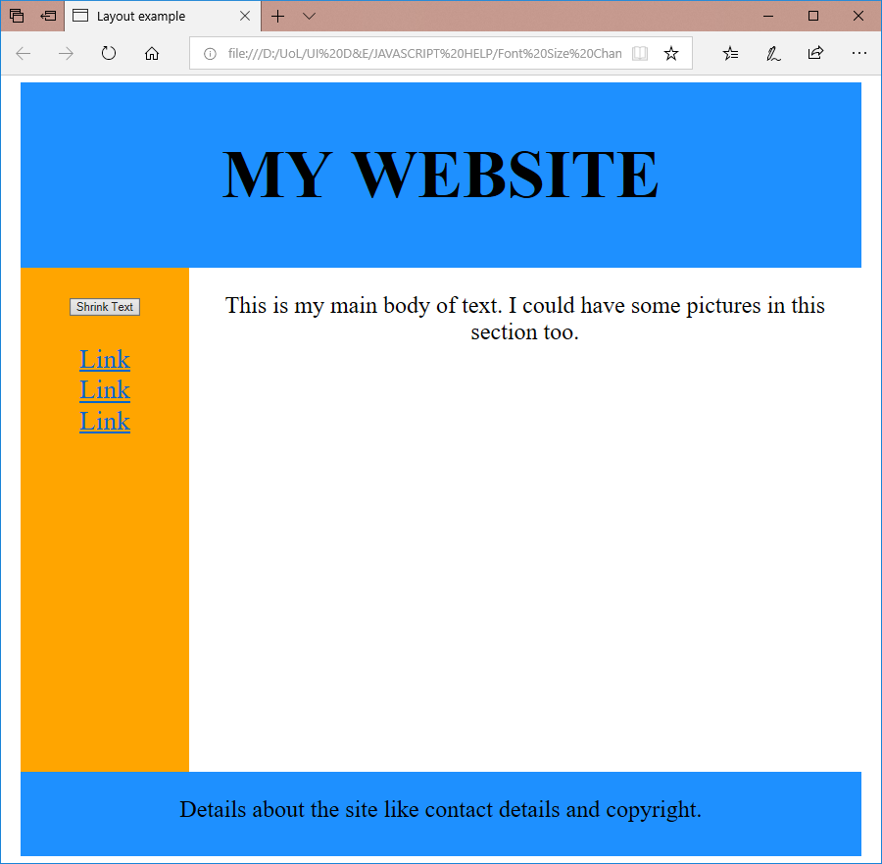

Now to test your code.
You should see that when you run your HTML code you will have one buttons placed on the links navigation bar.
When you click on this the text in the main part of the website becomes smaller.

Slide 9
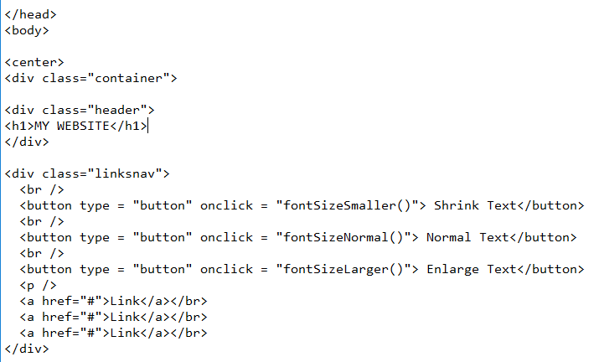
Changes to the HTML File – adding more buttons
Now you have a button to shrink the text it would be good to have buttons to enlarge this text, and to reset it back to how it was.
So copy the code for the initial button that you made, and paste that below it.
Then change the text and function name as I have in my code.

Slide 10
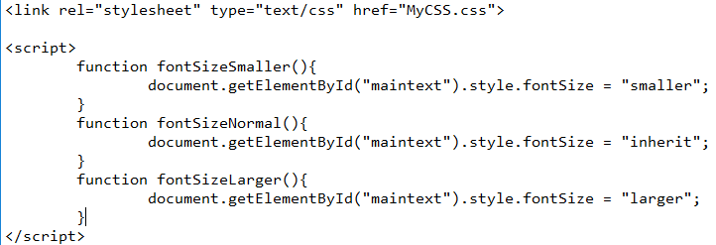
Now for the additional JavaScript
Now in the JavaScript I have again copied and pasted the code for my first function, and changed the function names to match what I placed in the buttons.
One function will make the text “larger”, which increases the size of what ever text you have.
The middle button resets the text to the original size. This is why fontSize = “inherit”. This will look at the CSS and use that size for the “mainSection”

Slide 11
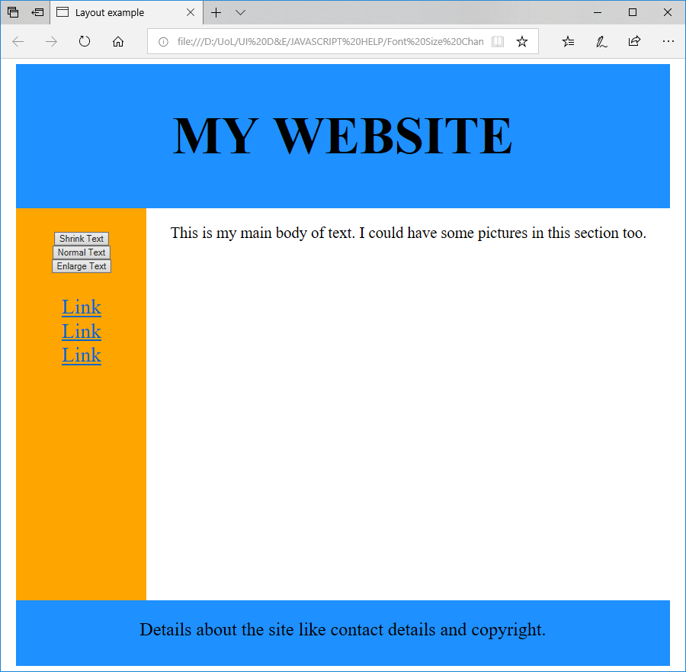
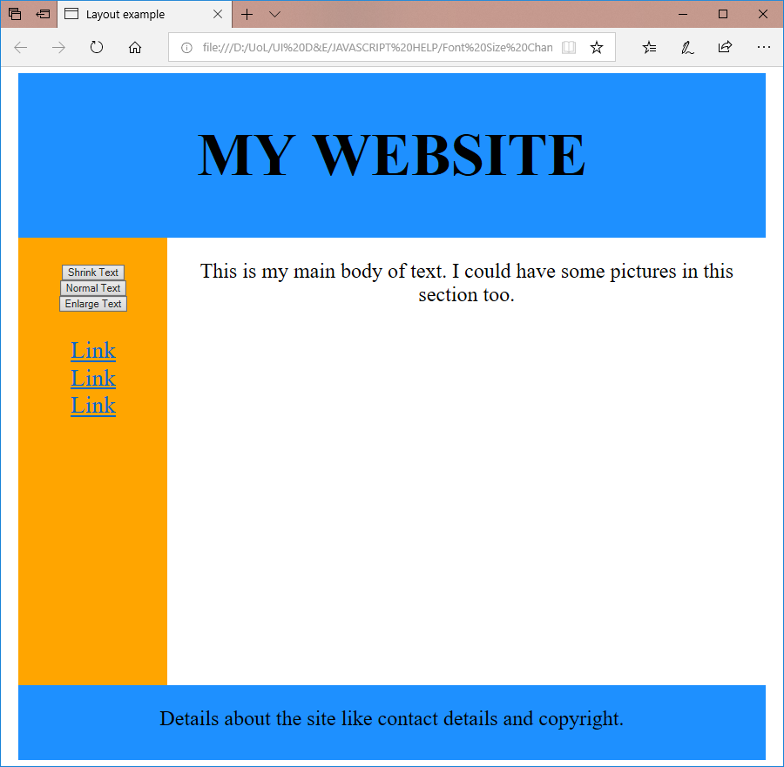

Now to test your code.
You should see that when you run your HTML code you will now have three buttons placed on the links navigation bar.
When you click on each of these it will change the size of the text.
Instead of using “smaller” or “larger”, you can also use 12px (or other pixel sizes) instead.

Slide 12
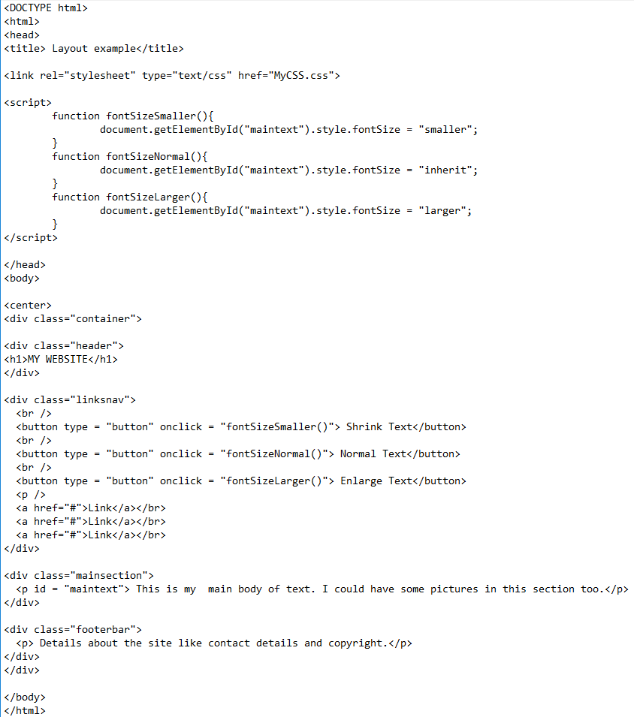
The final code…

Slide 13
Useful links…
For CSS and general HTML support
https://www.w3schools.com/css/default.asp
For support with HTML layout
https://www.tutorialspoint.com/html/html_layouts.htm
For the options for colours you can use in HTML.
https://www.rapidtables.com/web/css/css-color.html#cyan

